Slide 1
EZ QUIZ
Presented By:
Hasib Hasan
CS Student , KUET

Slide 2
Objectives:
To provide an interactive and user-friendly desktop application that enhances the educational experience by facilitating seamless communication between teachers and students, promoting active learning through timed quizzes, and enabling comprehensive result analysis while ensuring the integrity of the assessment process

Slide 3
Introduction:
In the ever-evolving landscape of education, fostering engagement and active participation among students is paramount. With this goal in mind, I am delighted to introduce "EZ Quiz," a dynamic desktop-based software designed to transform the way teachers and students interact in a learning environment.
EZ Quiz is more than just a software application; it's a catalyst for collaborative learning. It serves as a bridge between educators and their students, offering a range of features and functionalities that make the learning process not only efficient but also enjoyable.

Slide 4







Process Flow of Teacher Panel:
See Question
Search
Delete
Home Page
Result
Add Question
1
3
5
7
2
4
6
Teacher Login
Update
Add
Delete
Update

Slide 5



Process Flow of Student Panel:
Home Page
Attempt Quiz
See Result
1
3
5
2
4
Student Login
Solutions

Slide 6
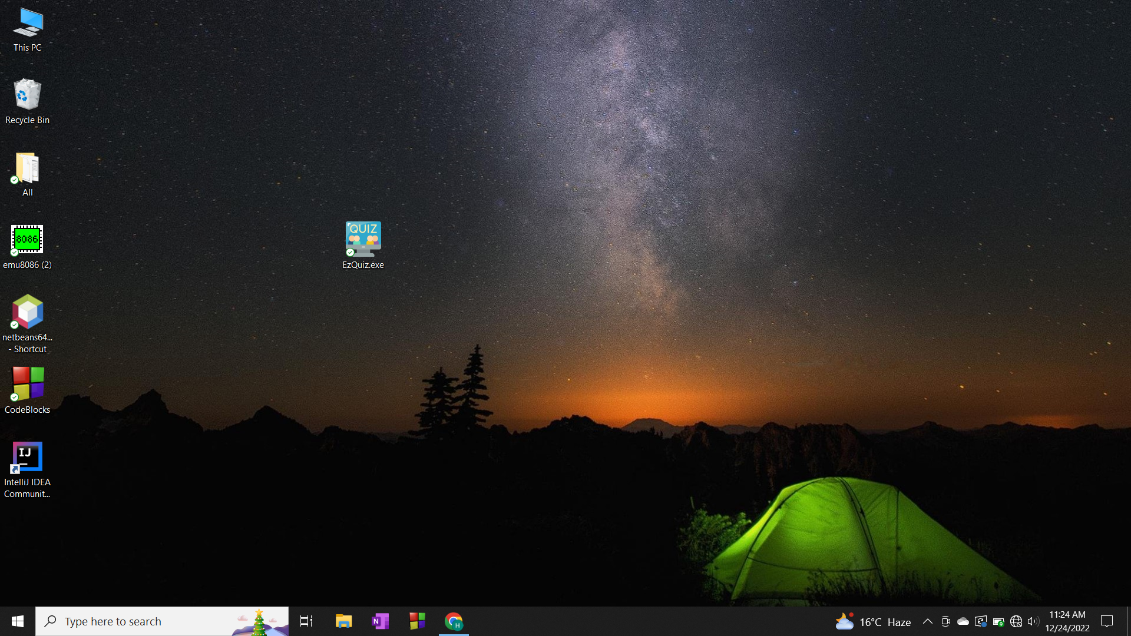
Opening EzQuiz.exe:

Slide 7
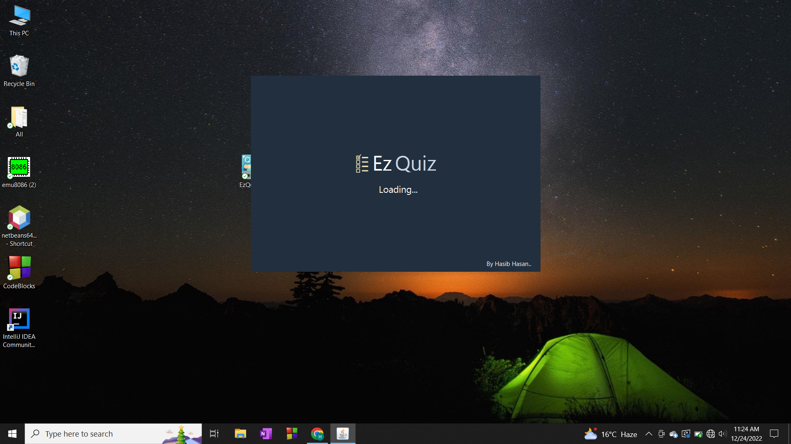
Splash Screen :
Fig. 04

Slide 8
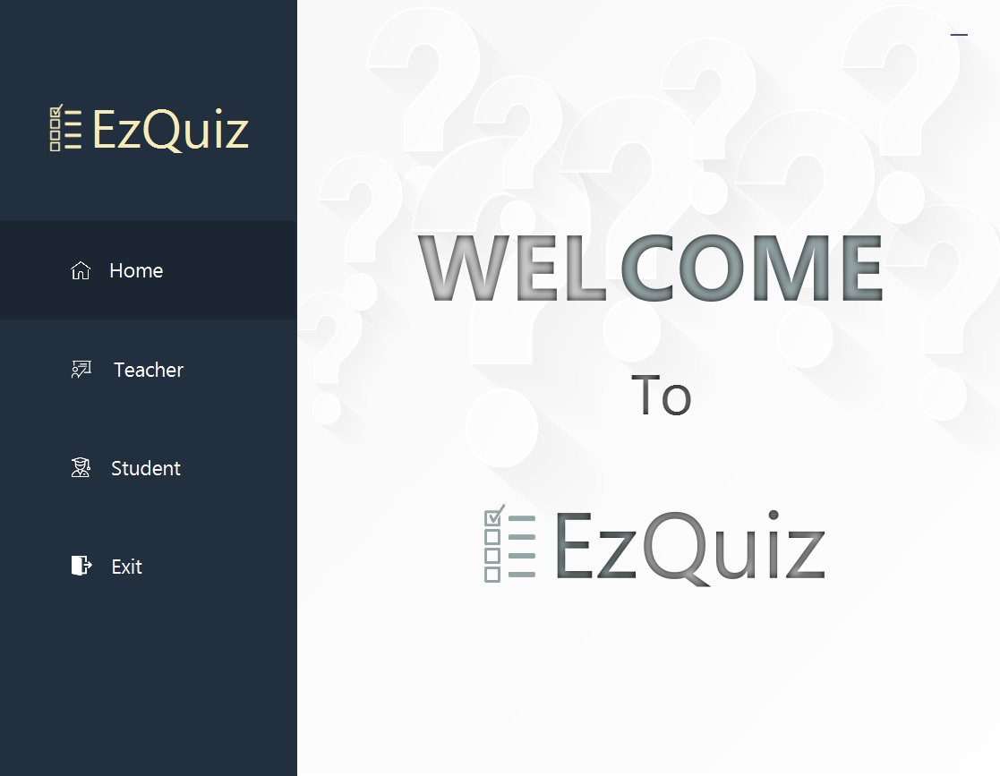
Home Page :
Fig. 05

Slide 9
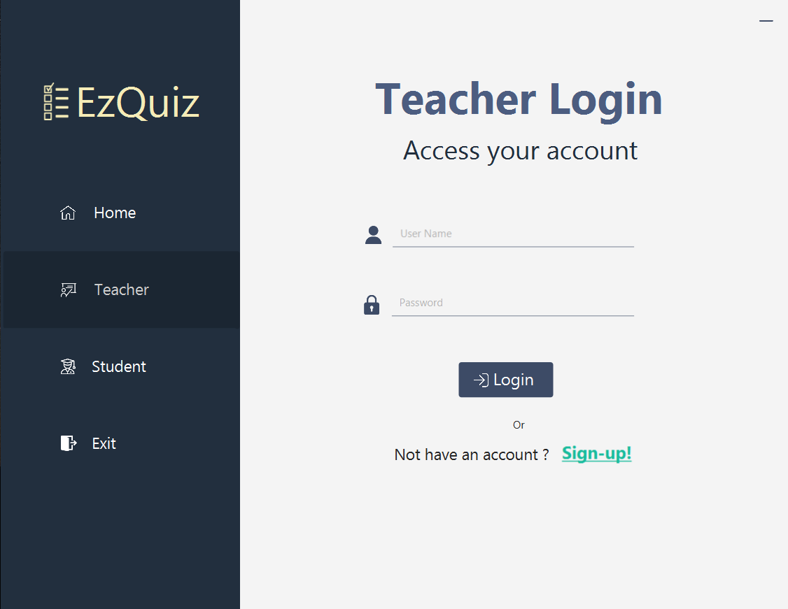
Teacher Login Page:
Fig. 06

Slide 10
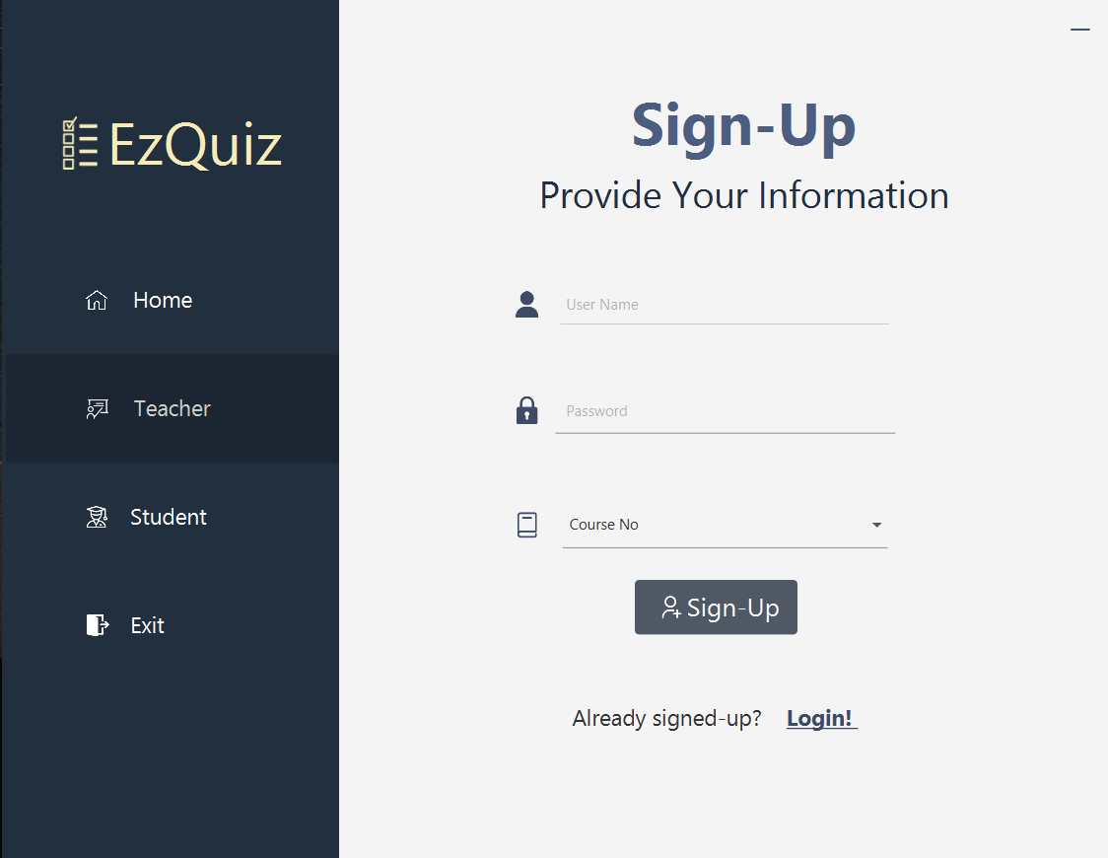
Sign-Up Page :
Fig. 07

Slide 11

Login with registered id & password:
Fig. 08

Slide 12
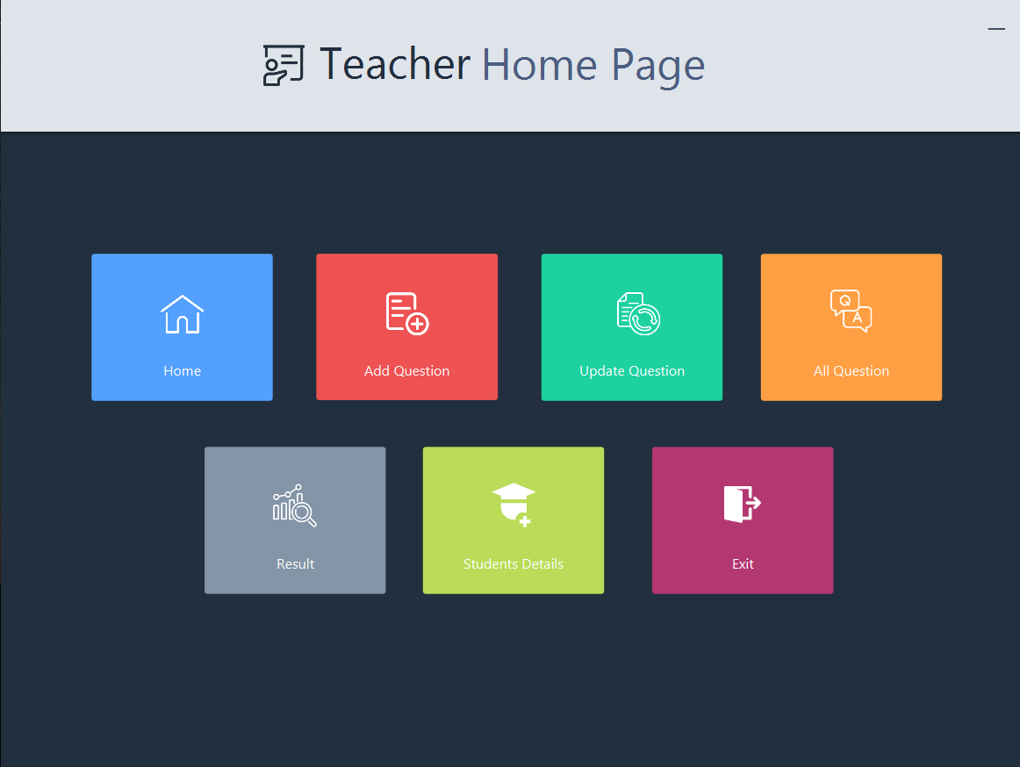
Teacher Home Page :
Fig. 09

Slide 13
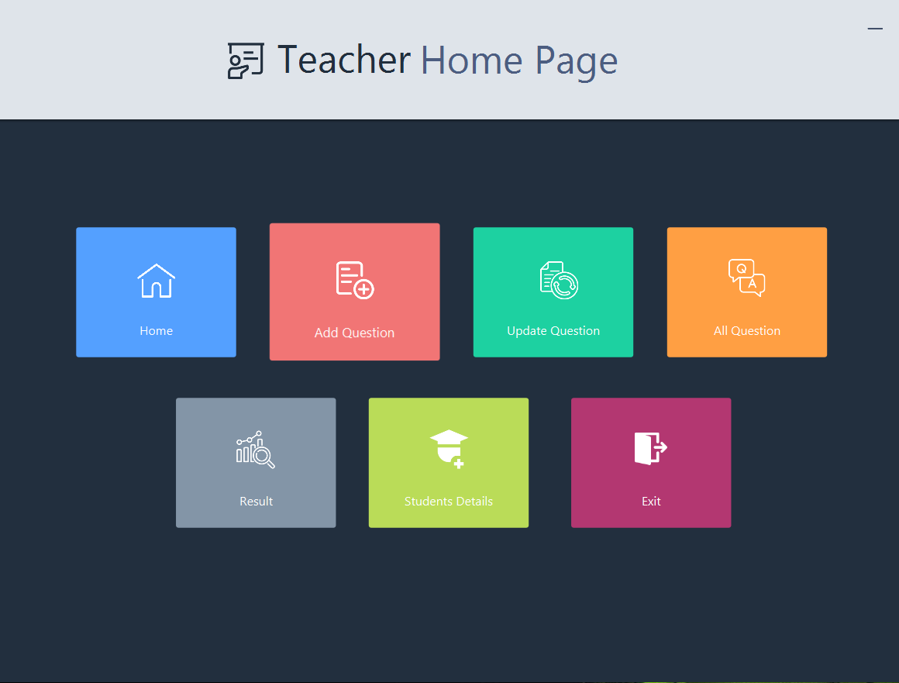

Teacher Home Page :
Fig. 10

Slide 14
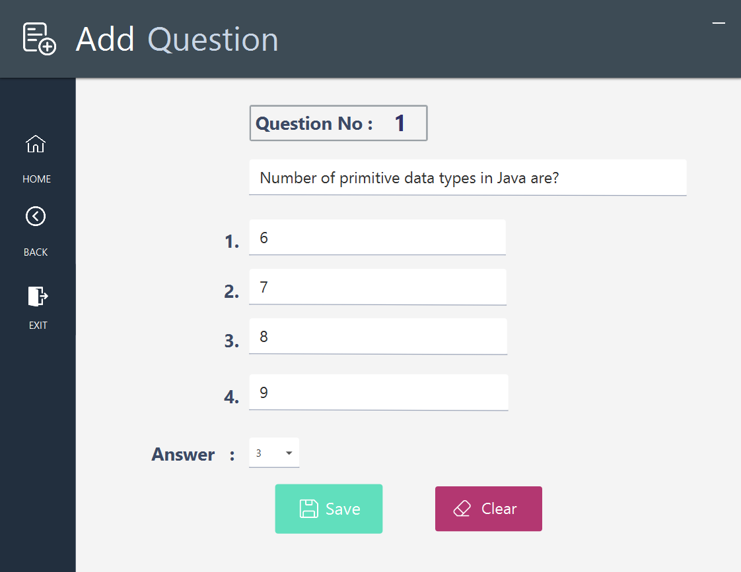
Add Question:
Fig. 11

Slide 15
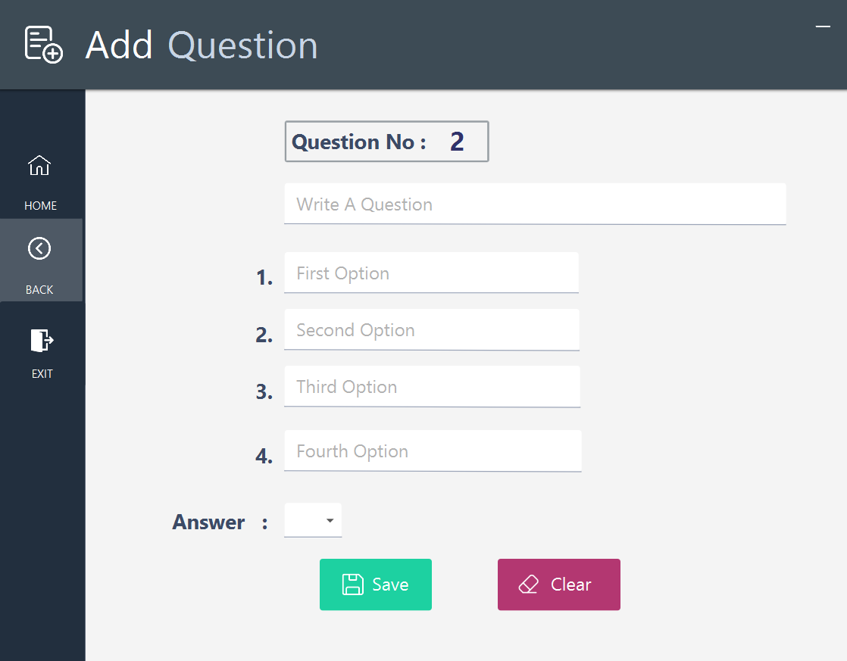
Add Question:
Fig. 12

Slide 16
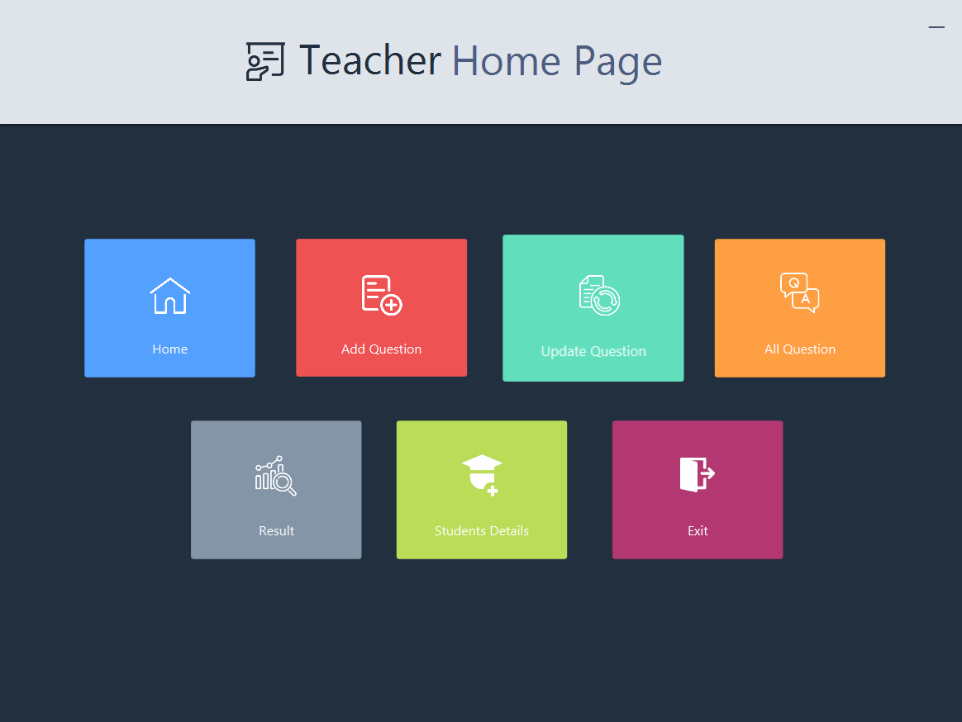
Teacher Home Page:
Fig. 13

Slide 17
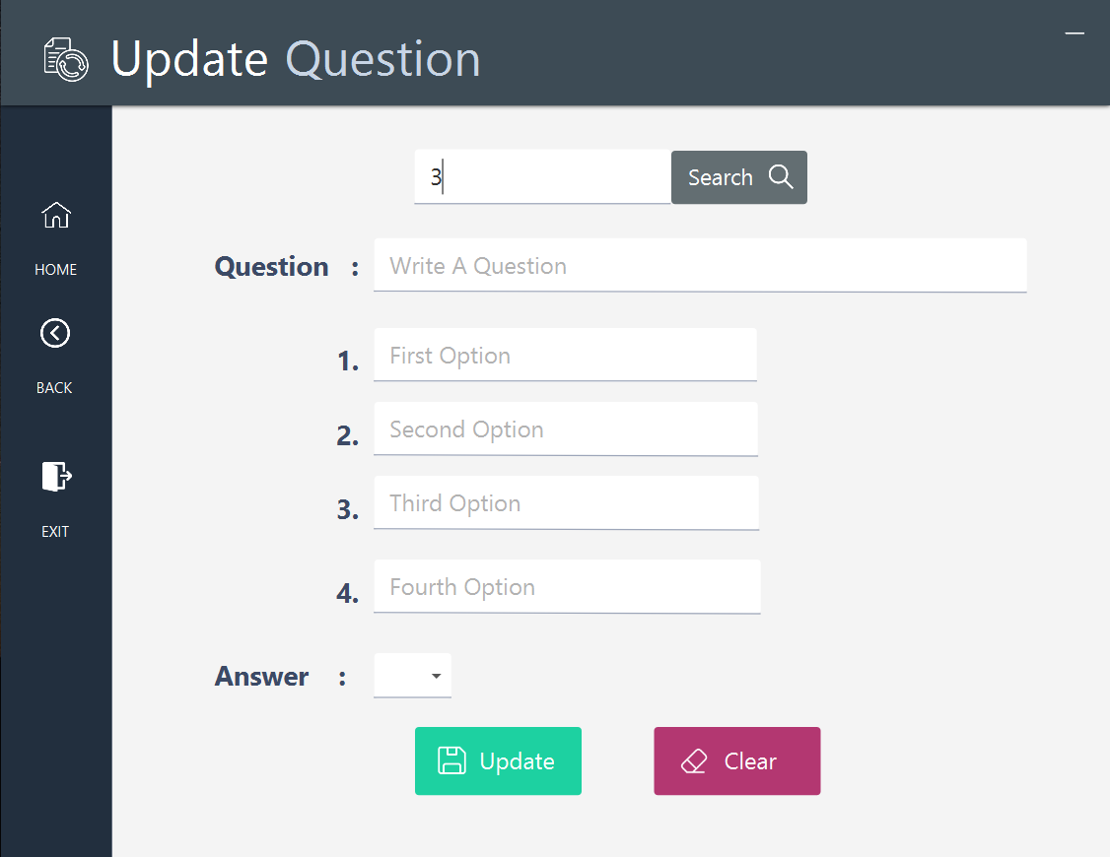
Update Question:
Fig. 14

Slide 18

Update Question:
Fig. 15

Slide 19
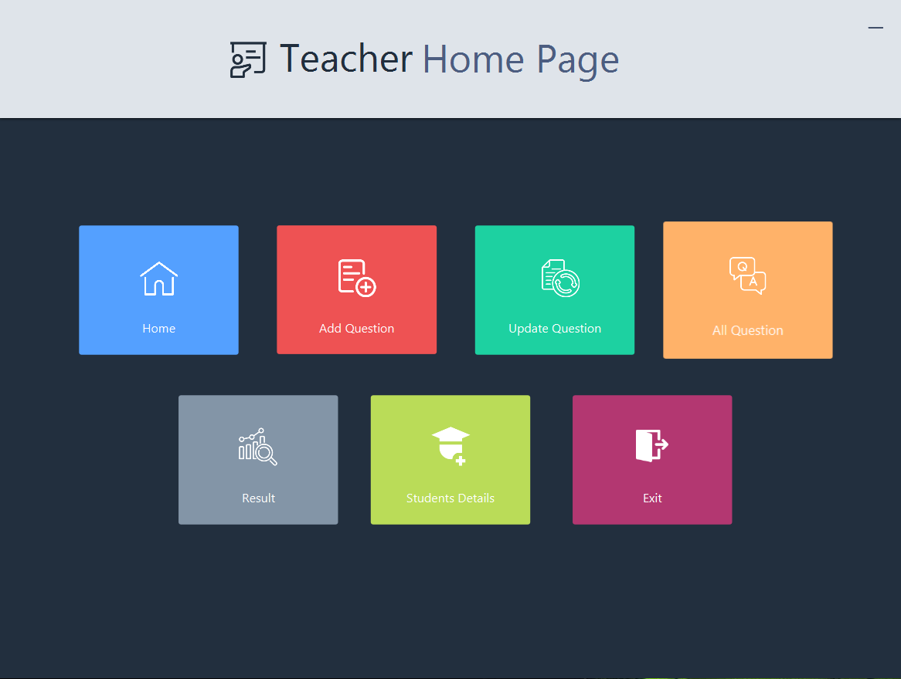
Teacher Home Page :
Fig. 16

Slide 20
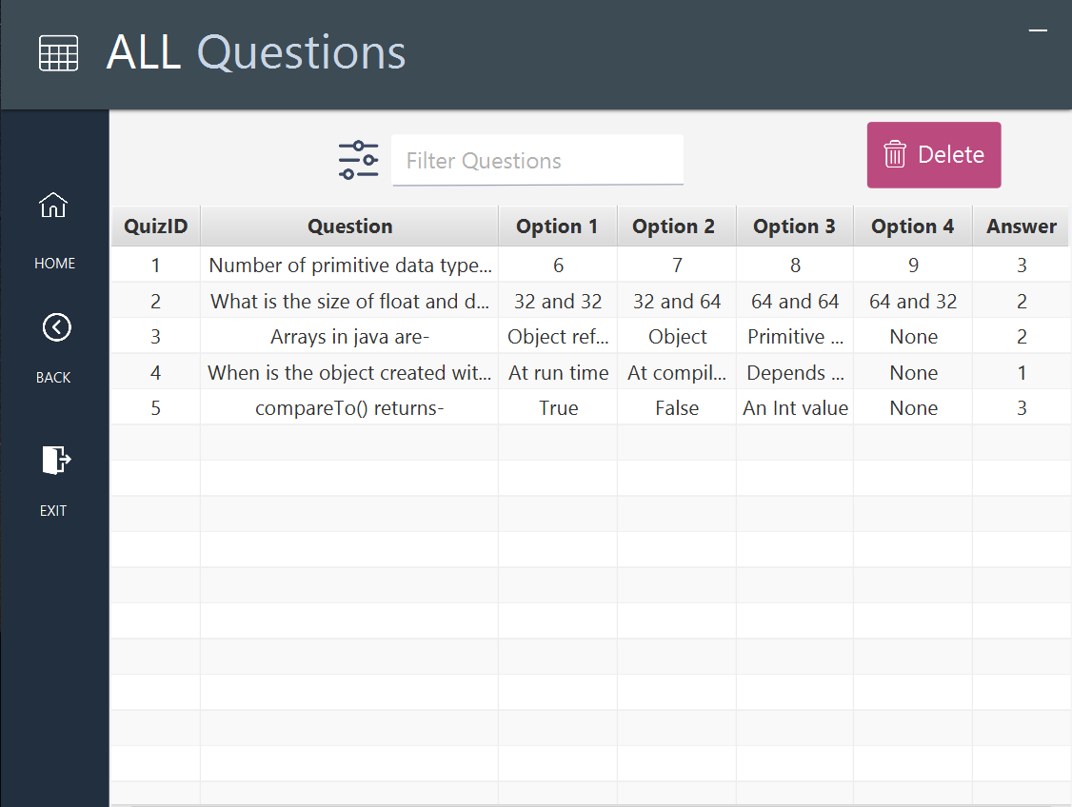
All Questions:
Fig. 17

Slide 21
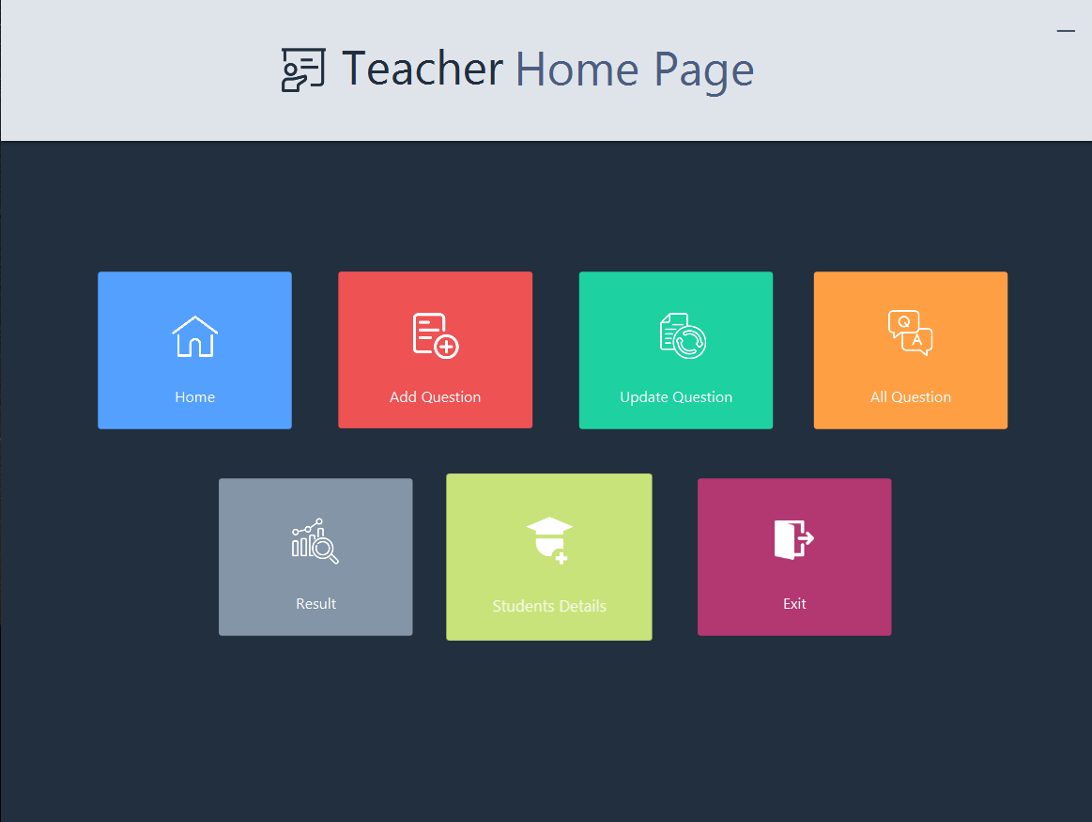
Teacher Home Page:
Fig. 18

Slide 22
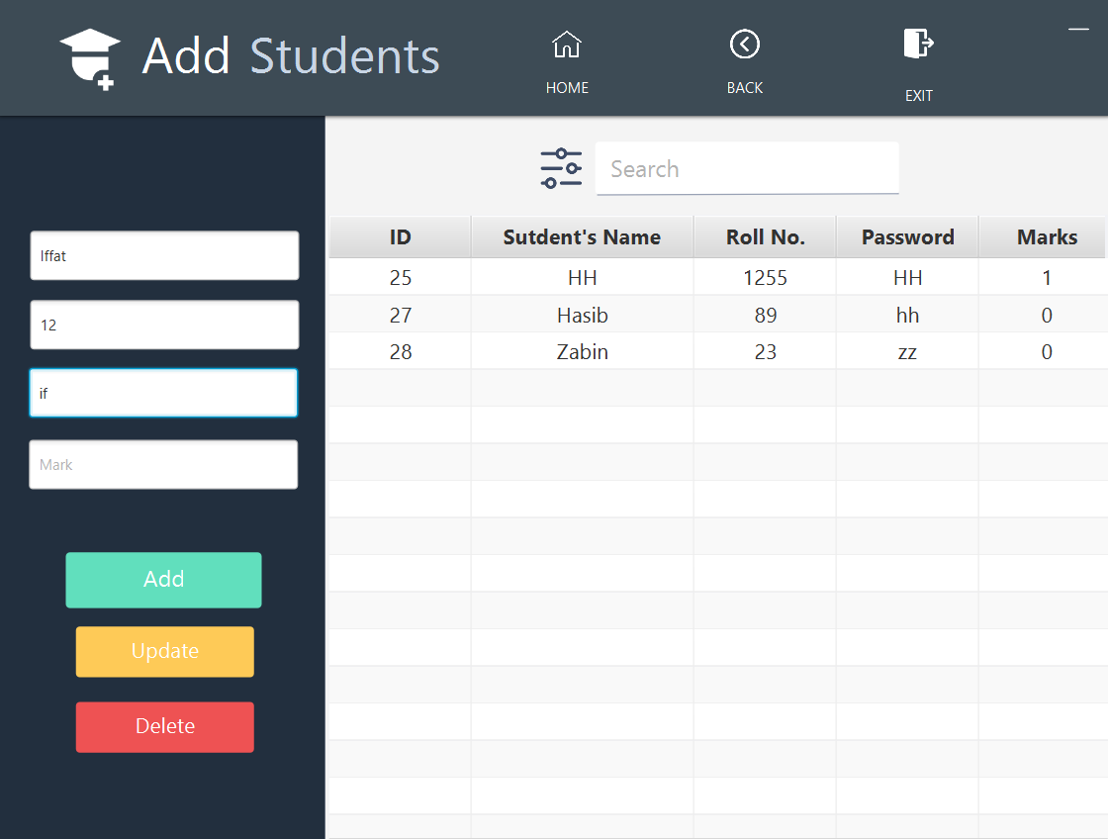
Add Student:
Fig. 19

Slide 23
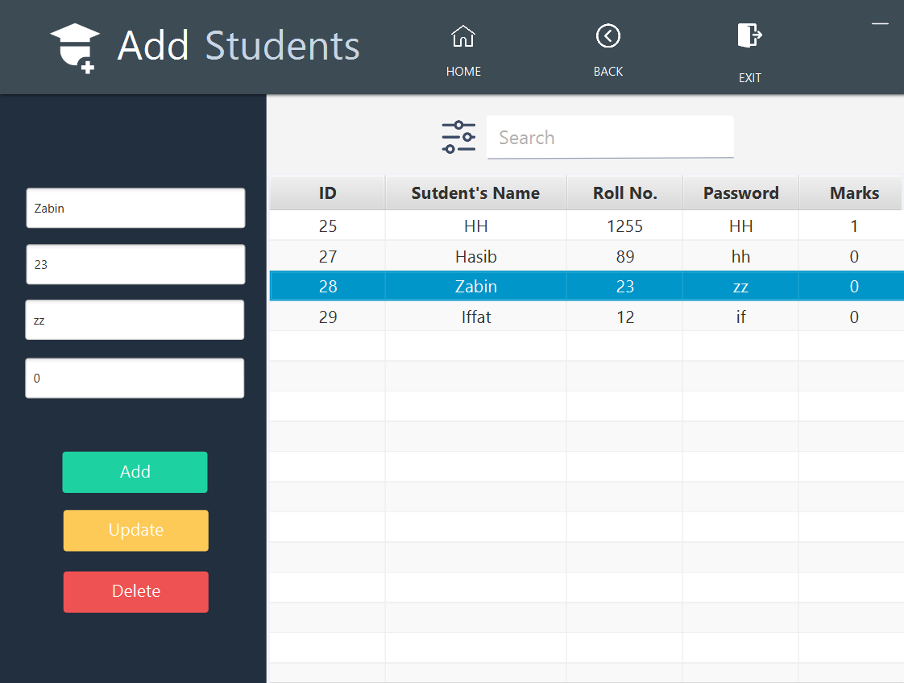
Select A Row to Update or Delete :
Fig. 20

Slide 24
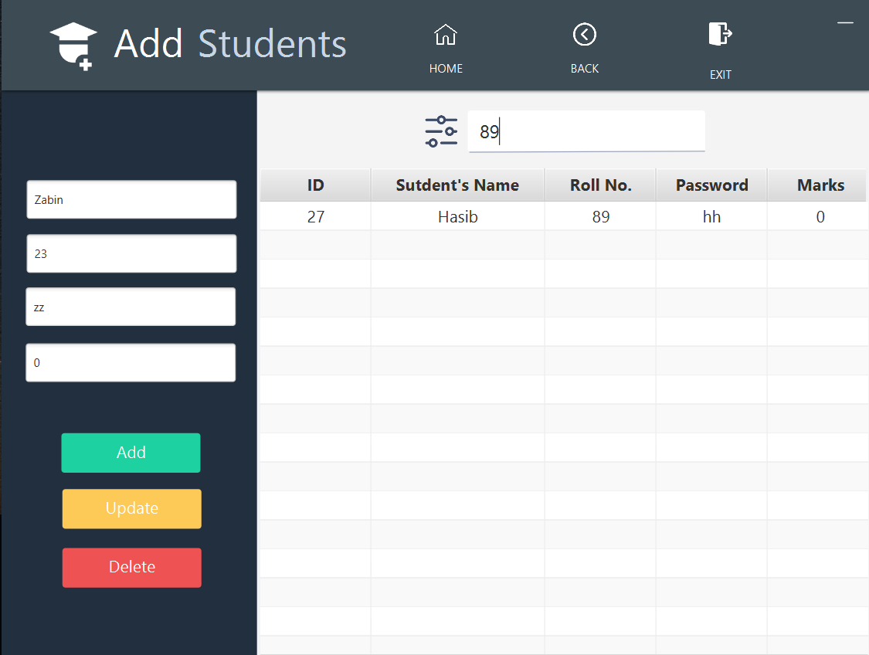
Search Student:
Fig. 21

Slide 25
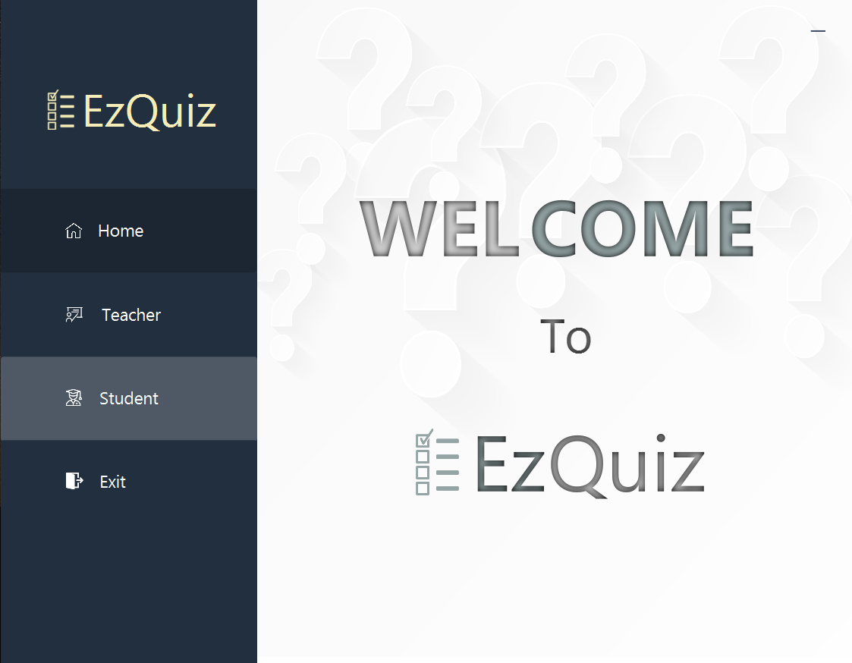
Home Page:
Fig. 22

Slide 26
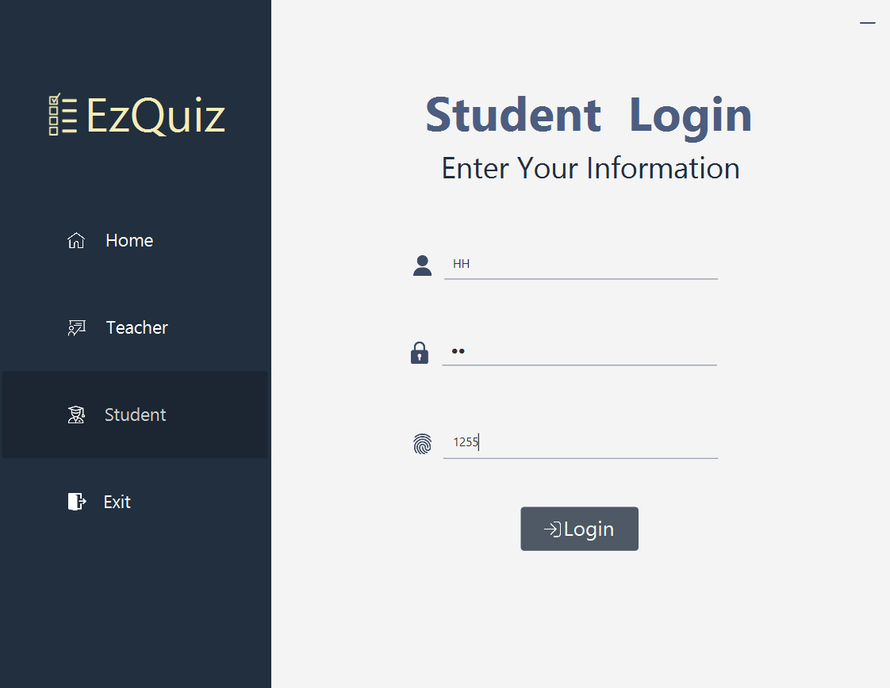
Login With Provided Information:
Fig. 23

Slide 27
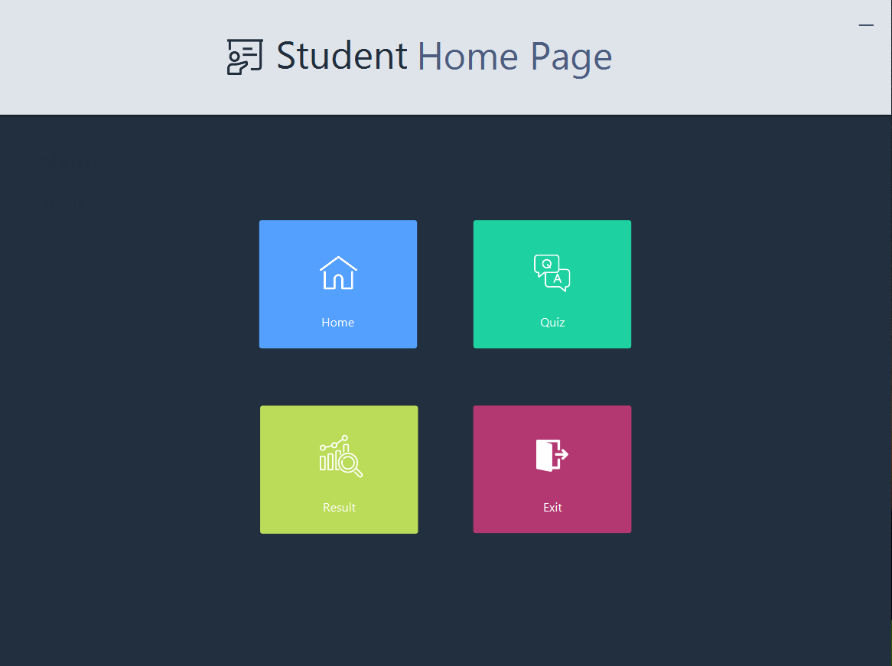
Student Home Page:
Fig. 24

Slide 28
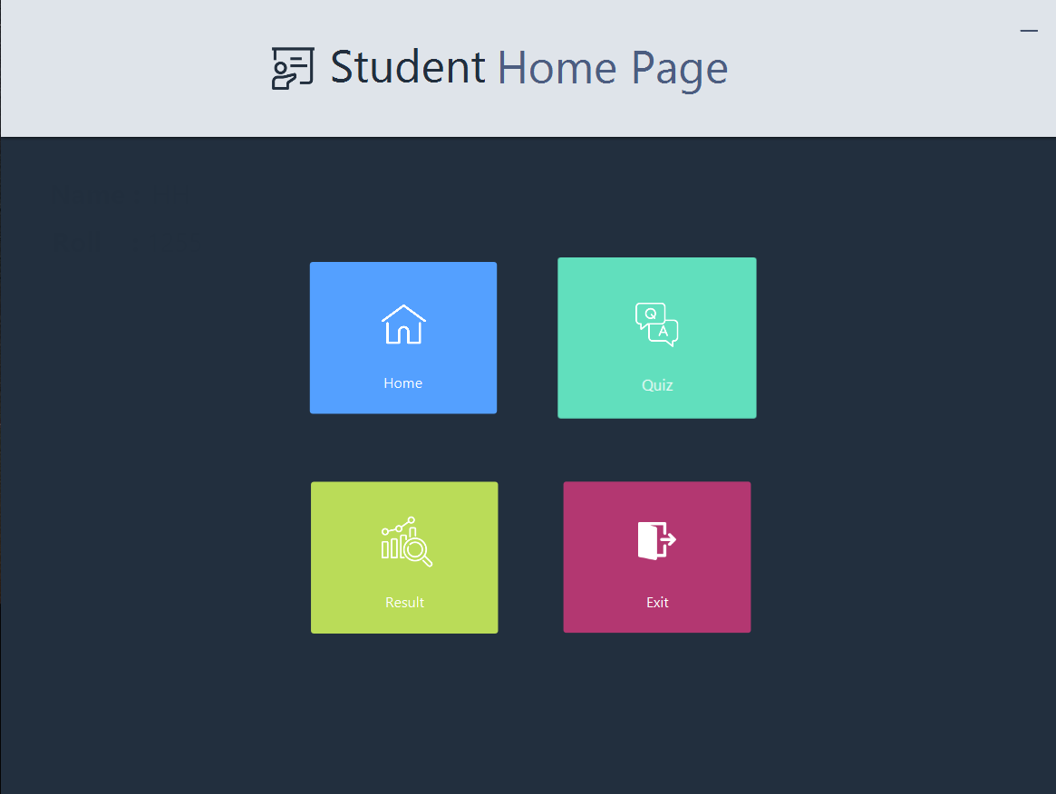
Student Home Page:
Fig. 25

Slide 29
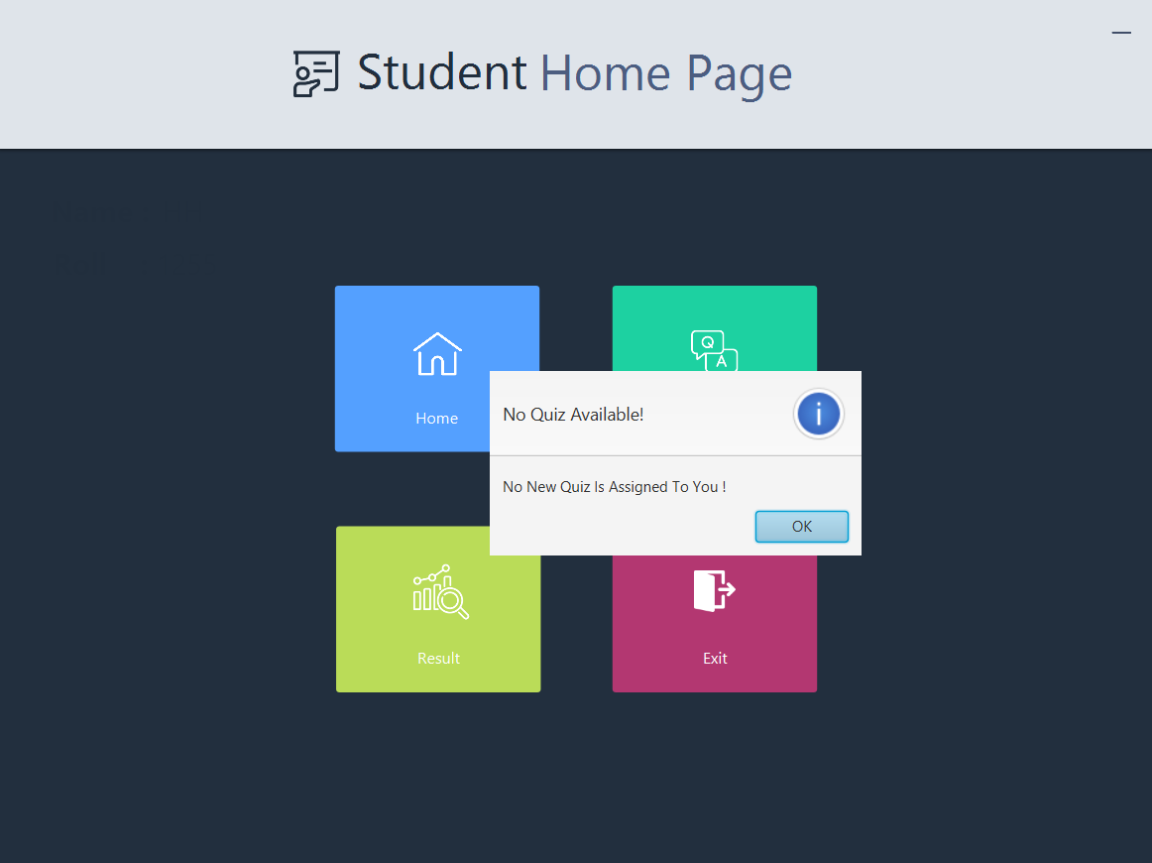
Quiz Already Attempted:
Fig. 26

Slide 30
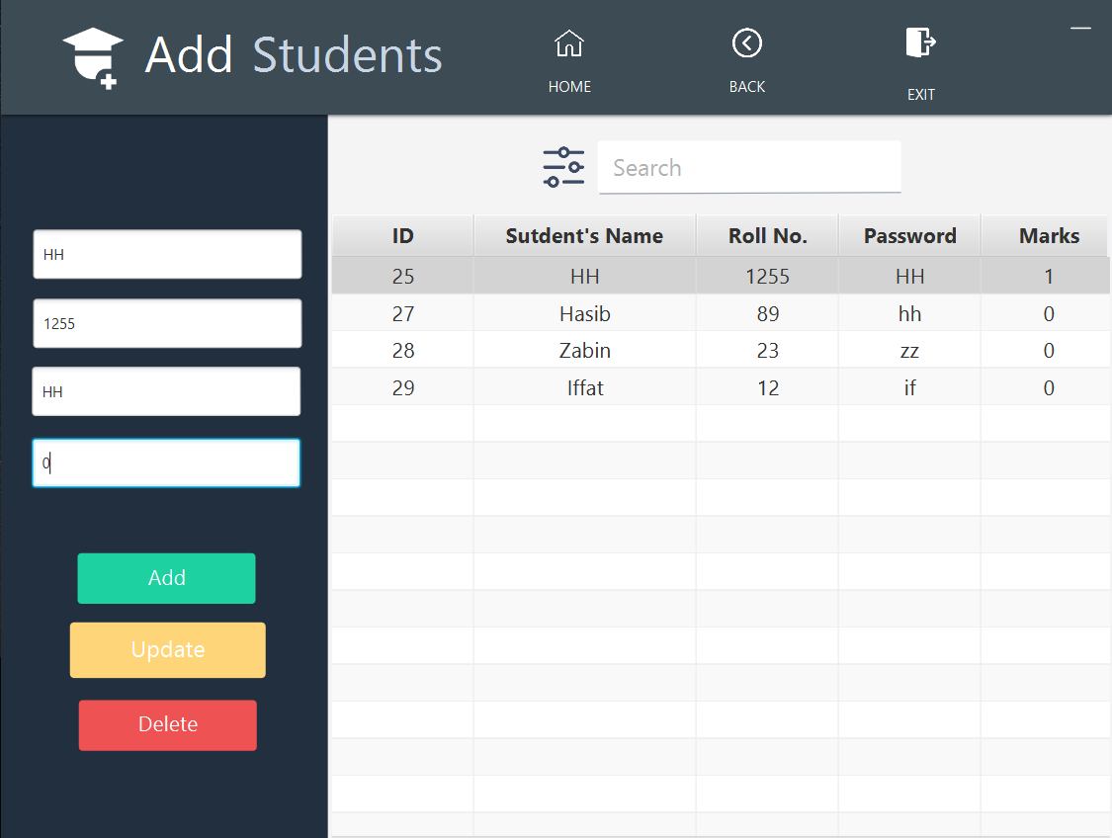
Allow Student To Attempt Quiz:
Fig. 27

Slide 31
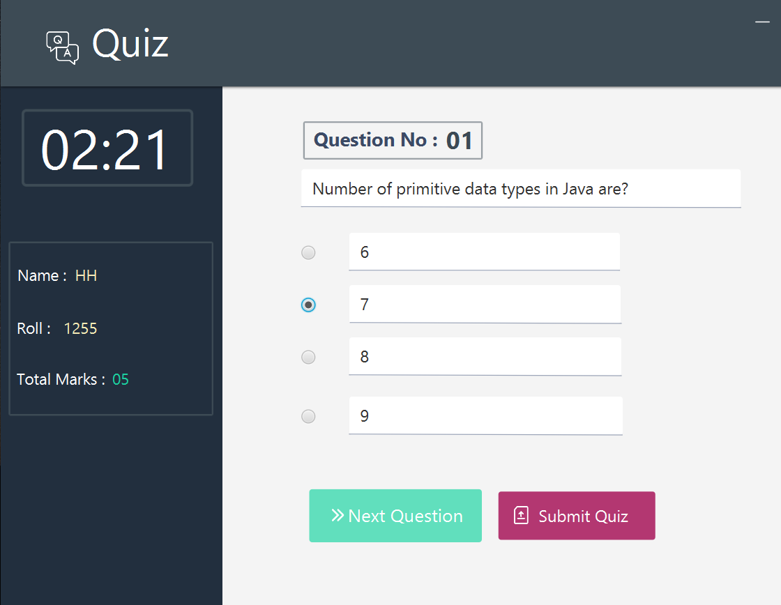
Quiz Starts:
Fig. 28

Slide 32

Quiz Continues.. :
Fig. 29

Slide 33
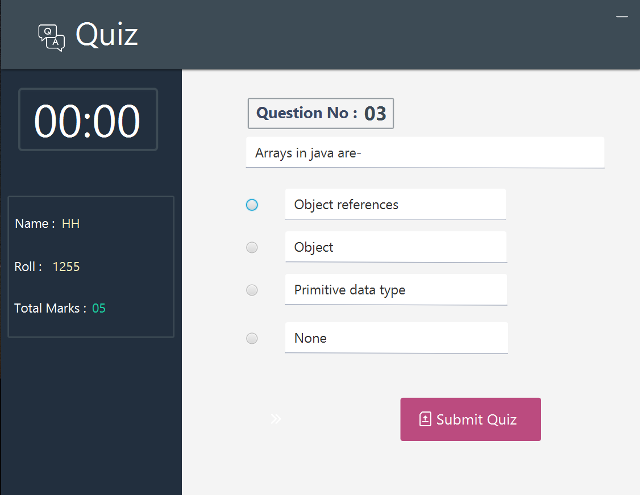
Time’s Up:
Fig. 30

Slide 34
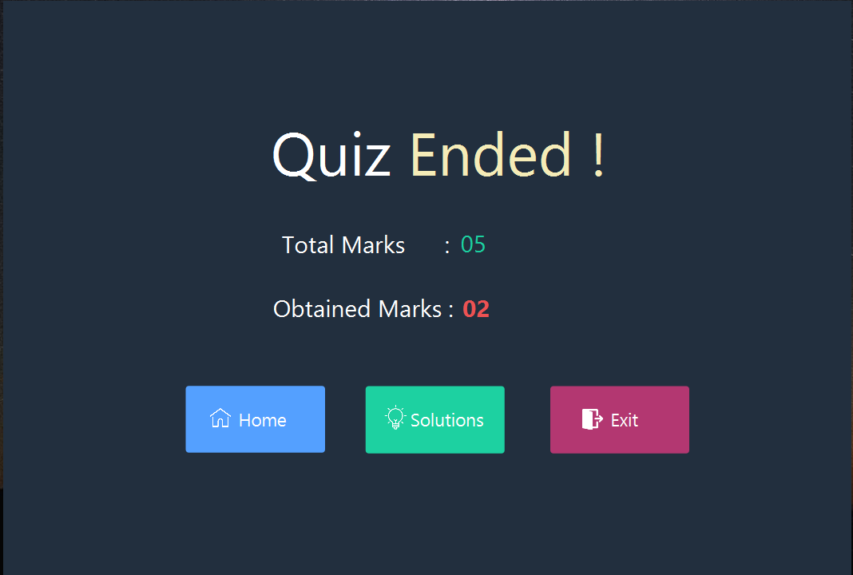
Quiz Ended:
Fig. 31

Slide 35

Quiz Ended:
Fig. 32

Slide 36
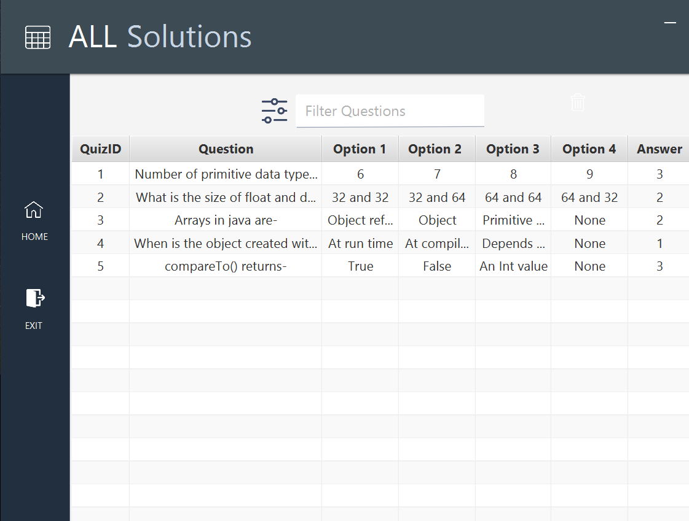
Solutions:
Fig. 33

Slide 37
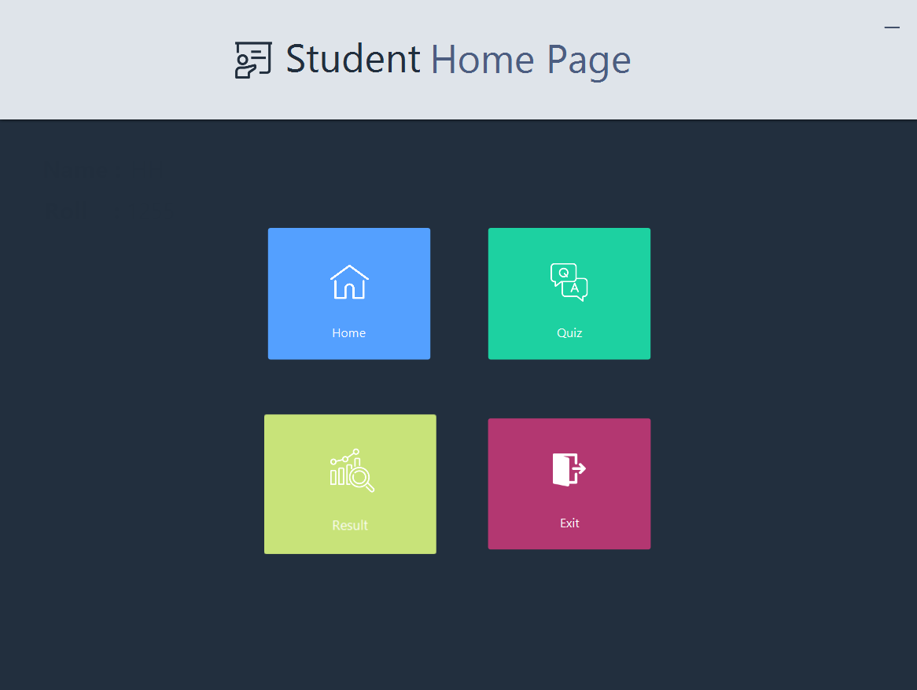
Student Home Page:
Fig. 34

Slide 38
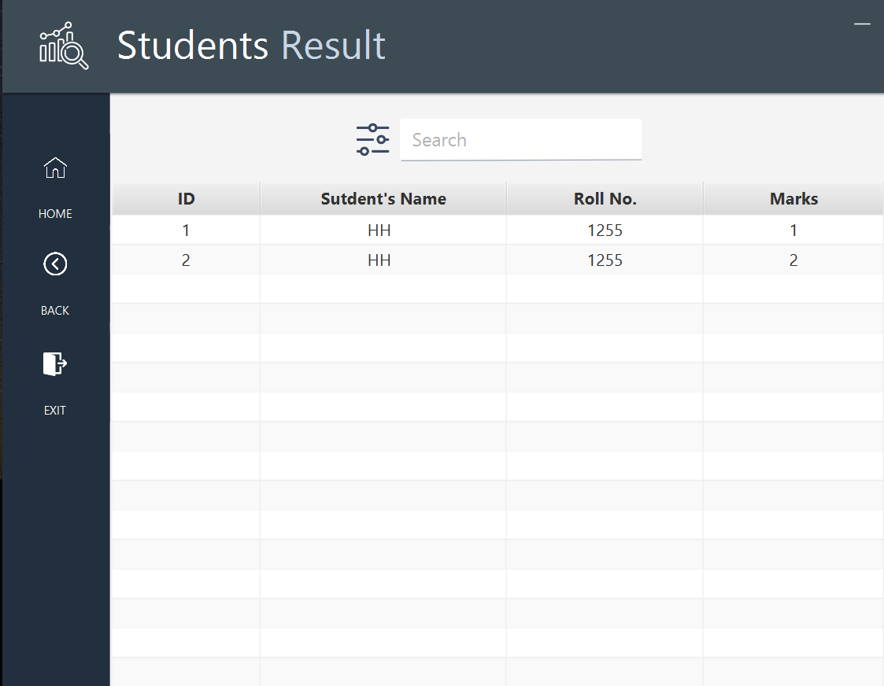
Results:
Fig. 35

Slide 39
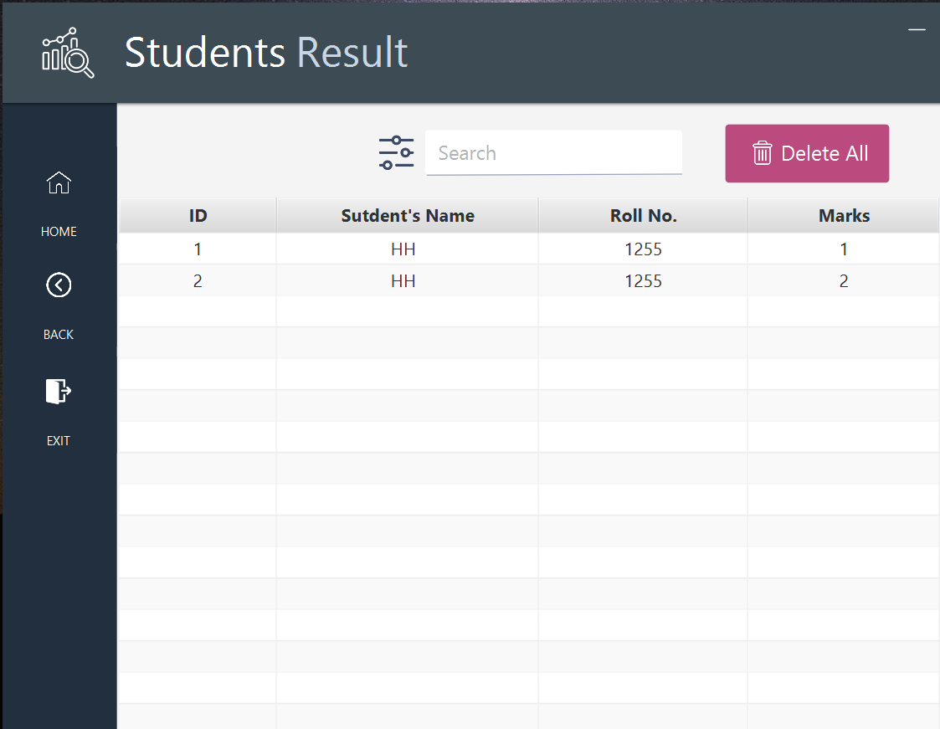
Results:
Fig. 36

Slide 40
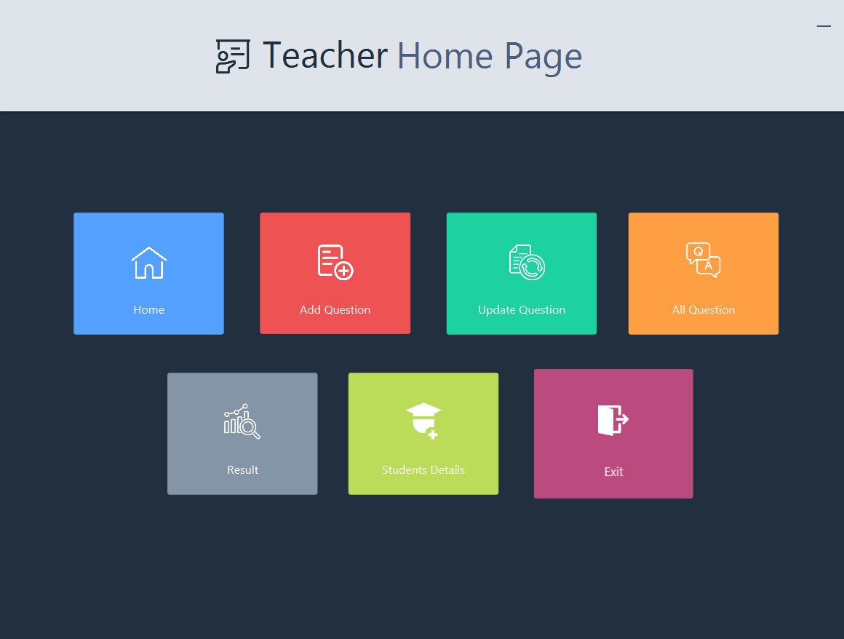
Exit:
Fig. 37

Slide 41
Future Work Plan:
Enhance Accessibility: We aim to make EZ Quiz more accessible by developing mobile versions, ensuring that learning can happen anywhere and anytime.
Intelligent Adaptive Learning: We're researching and developing adaptive learning algorithms to tailor quizzes and content to individual student needs, promoting a more personalized learning experience.
Integration with Learning Management Systems: We plan to integrate EZ Quiz seamlessly with popular learning management systems, making it even easier for educators to incorporate this tool into their teaching methods.
Global Collaboration: We envision EZ Quiz as a global platform for educators to collaborate, share content, and exchange best practices to foster innovation in education worldwide.

